Slide 1
Diamonds Price Prediction
CS - 513

Slide 2




Presenters
Manank Valand
10429101
Zhiyu Zhou
10431544
Mehul Mistry
10430980
Anushka Varade
10429876

Slide 3
Motivation and Objective
“Midstream US dollar revenues tracked the retail sector’s performance in 2015, declining 2%.The long-term outlook for the diamond market remains positive.”
The pricing of other jewelry like diamond rings is more complicated because they are not as standardized as gold jewelry. The price of diamond jewelry depends on the four C's: caratage, cut, colour, and clarity of the diamond stone.
A good cut gives a diamond more sparkle. Colourless diamonds are the most prized. Cut, colour, and clarity are subjective factors and are very hard for the layman to gauge.
Goal: To build model which helps to determine the price accurately.

Slide 4
Introduction(1/2)
This dataset includes almost around 53,000 diamonds’ details.
Metadata Contains:
Carat - Weight of the diamond (0.2--5.01)
Price in US dollars (\$326--\$18,823)
Cut - Quality of the cut (Fair, Good, Very Good, Premium, Ideal)
Color - Diamond colour, from J (worst) to D (best)
Clarity - a measurement of how clear the diamond is (I1 (worst), SI2, SI1, VS2, VS1, VVS2, VVS1, IF (best))
X - length in mm (0--10.74)
Y - width in mm (0--58.9)
Z - depth in mm (0--31.8)
Depth - total depth percentage = z / mean(x, y) = 2 * z / (x + y) (43--79)
Table - width of top of diamond relative to widest point (43--95)
https://www.kaggle.com/shivam2503/diamonds/data

Slide 5
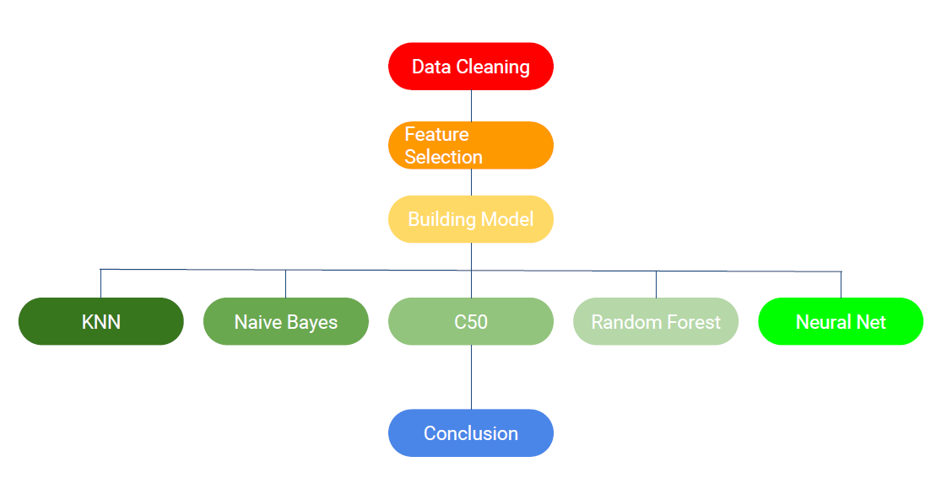
Introduction(2/2)

Slide 6
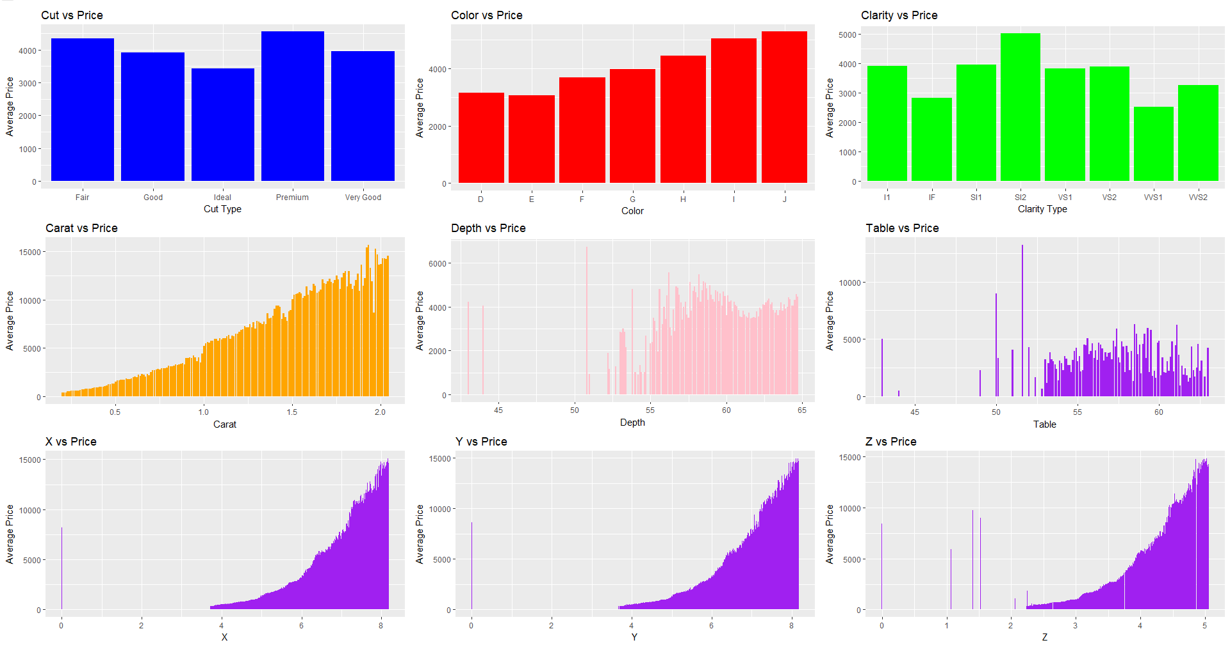
From this graph we can see that carat, x, y, and z are important features

Slide 7
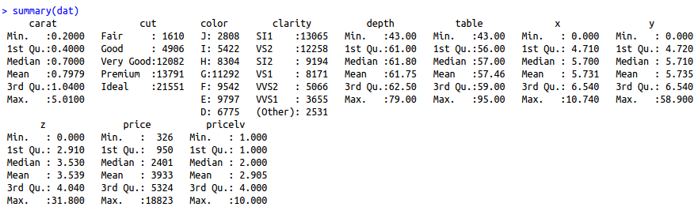
Preprocessing
Clean data so need to do that
Labeled the column cut, color, clarity

Slide 8
Linear Regression (1/2)
columns | carat | cut | color | clarity | depth | table | x | y | z
Multiple R-squared | 0.8493 | 0.0128 | 0.0312 | 0.0271 | 0.00011 | 0.0161 | 0.7822 | 0.749 | 0.7418

Slide 9
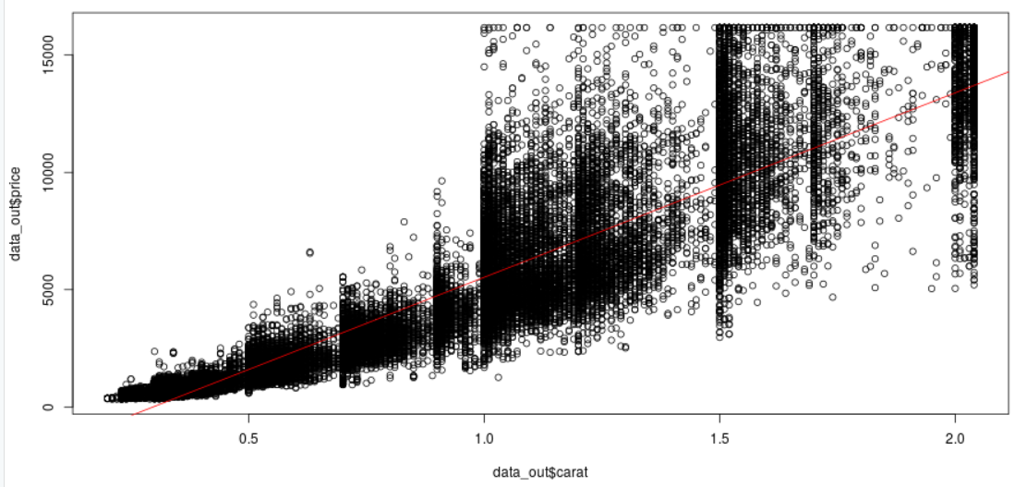
Linear Regression (2/2)

Slide 10
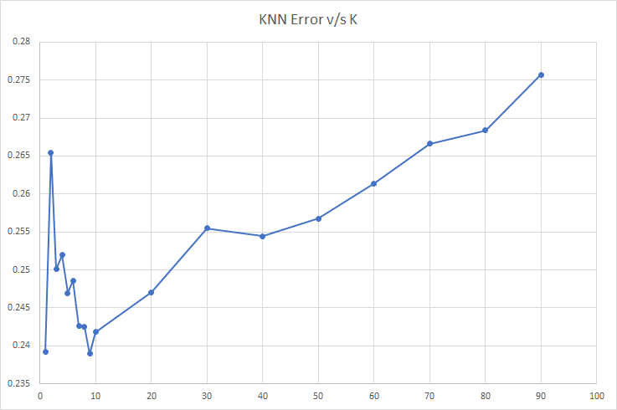
KNN
Applied different K values
Graph of K v/s Error rate

Slide 11
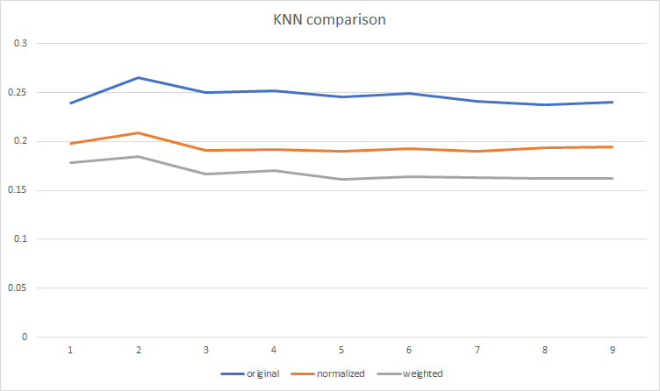
KNN

Slide 12
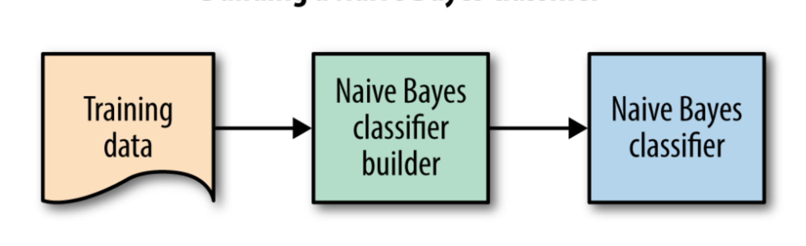
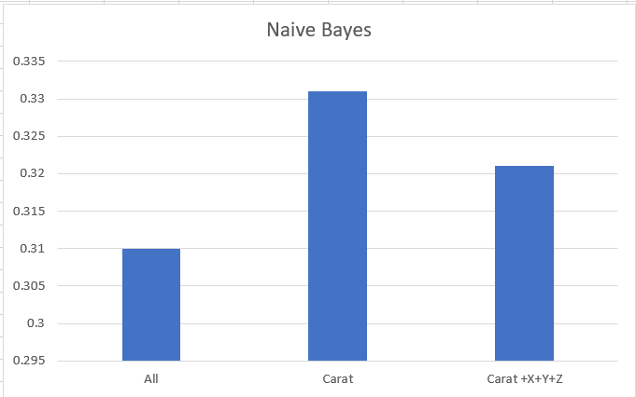
Naive Bayes Classification
Train the datasets
Used different attributes for building model
a. Carat+x+y+z
b. Carat
c. All

Slide 13
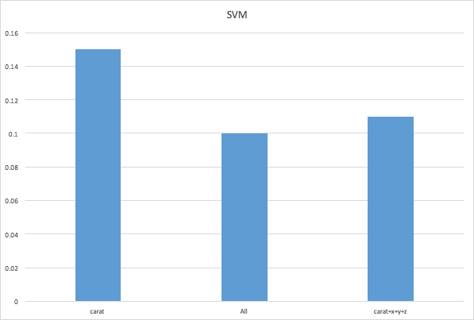
SVM
Train the datasets
Used different attributes for building model
Used “Linear” kernel
a. Carat+x+y+z
b. Carat
c. All

Slide 14
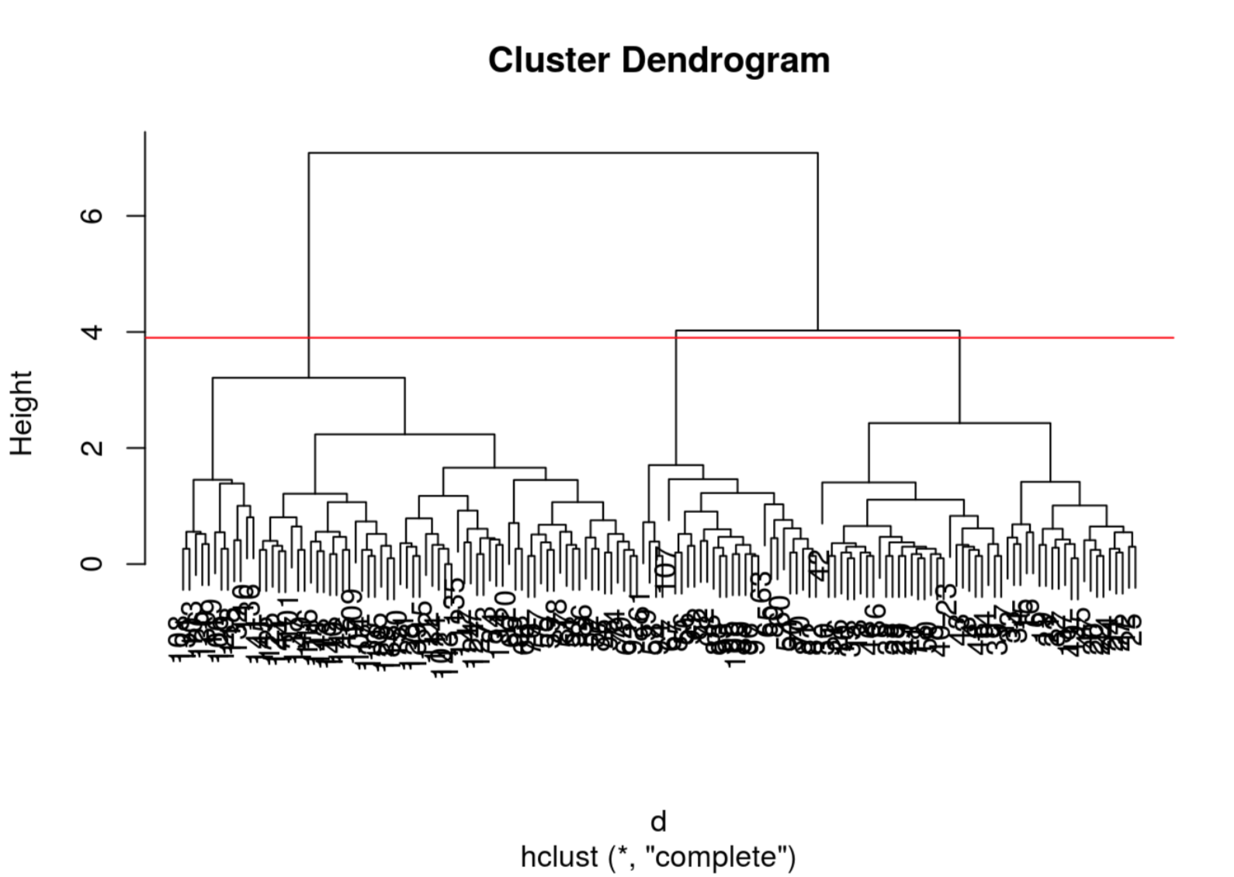
Clustering
H Clustering
Too big data to compare because distance function produces the larger intermediate values to compare.

Slide 15
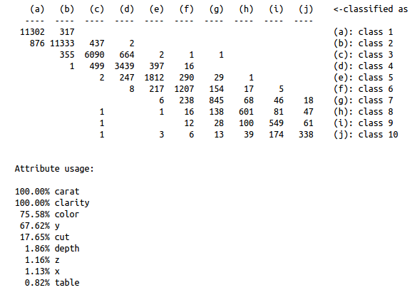
Decision Tree(C5.0)
Error Rate: 0.171

Slide 16
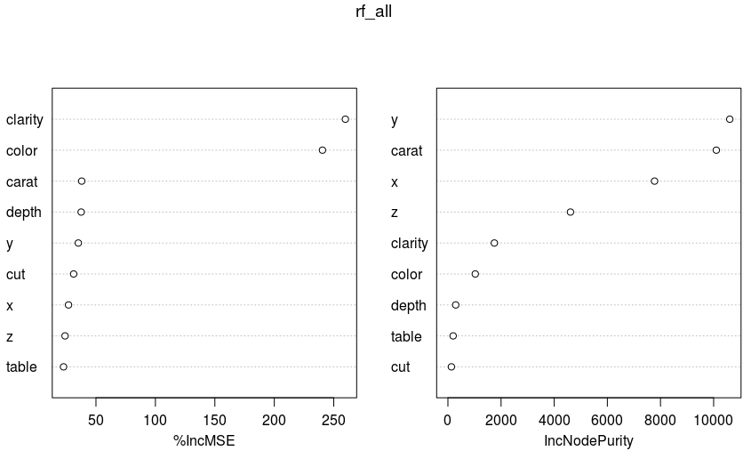
Random Forest
Error Rate - 0.182
But attribute importance are different from previous method.

Slide 17
ANN (1/2)
And if we use it across all the features,
Algorithm could not converge. (even after changing hidden nodes and threshold and maxStep.)
So we tested it only across Carat.
ann_res<-neuralnet(lv1+lv2+lv3+lv4+lv5+lv6+lv7+lv8+lv9+lv10~carat+cut+color+clarity+depth+table+x+y+z, training, hidden=10, threshold=0.01)

Slide 18
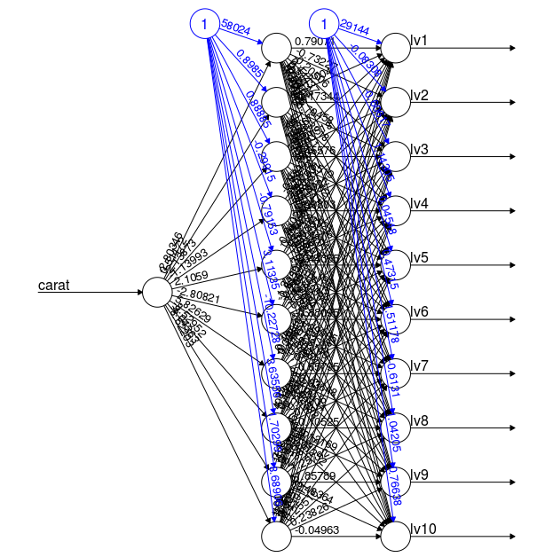
ANN (2/2)
ann_res<-neuralnet(lv1+lv2+lv3+lv4+
lv5+lv6+lv7+lv8+lv9+lv10~carat,
training, hidden=10,
threshold=0.1)
And Error Rate is: 0.065

Slide 19
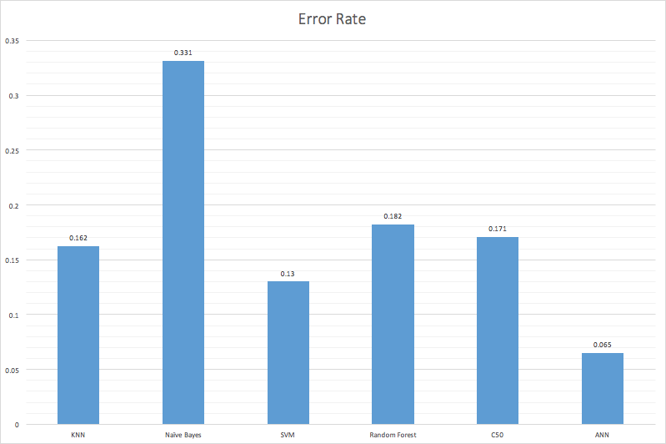
Comparing Models

Slide 20
Conclusion
The diamonds data set has a moderate positive correlation between carat and diamond price, especially in diamonds with weights higher than 1 carat.
For predicting prices of diamonds above 1 carat. Other attributes such as cut and clarity, have a greater impact in prices.
ANN outperforms from all other models
The selection of attributes has the great impact on results.
For better prediction of price, all the attributes must be there.

Slide 21
Thank You

